Slide 1
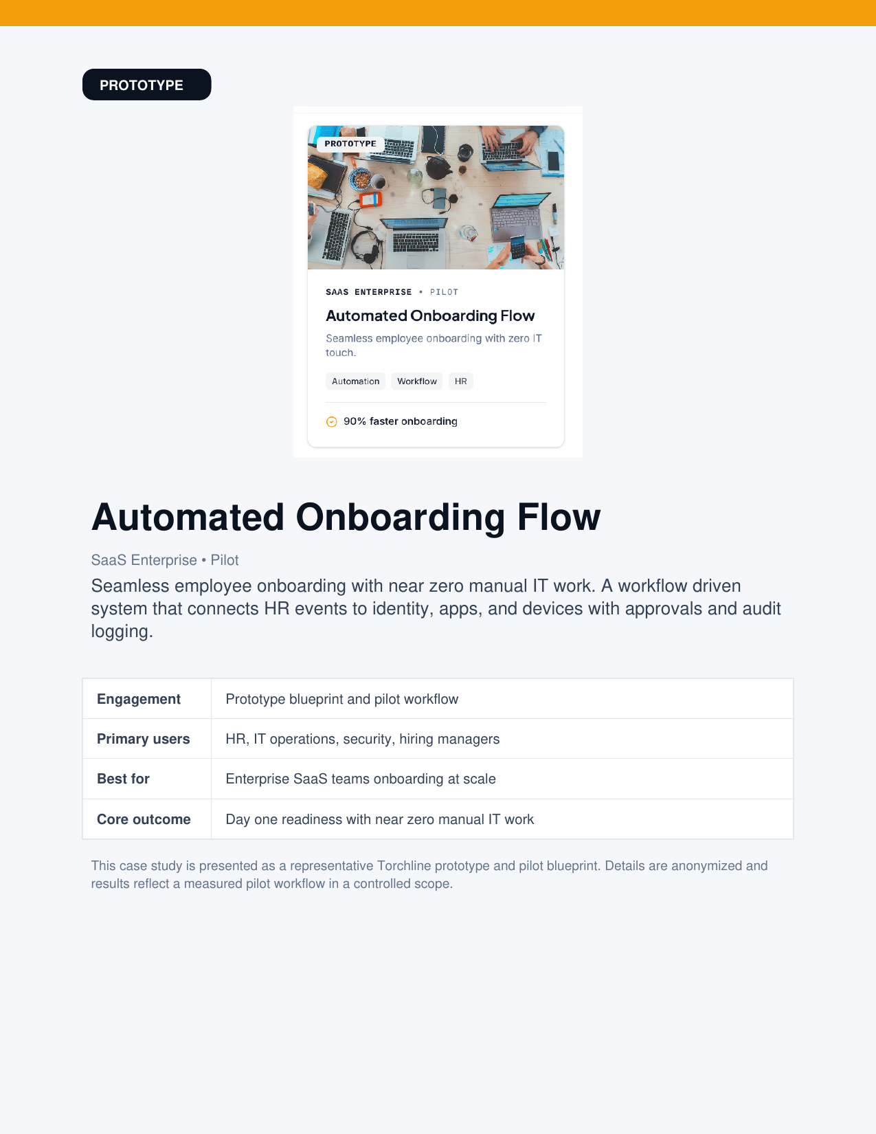
TORCHLINE
PROTOTYPE
Automated
Onboarding Flow
SaaS Enterprise • Pilot
Seamless employee onboarding with near zero manual IT work.
A workflow driven system that connects HR events to identity, apps,
and devices with approvals and audit logging.
90% faster onboarding (pilot)
Notes:
[Sources] - User-provided Torchline case study PDF (Automated Onboarding Flow), pages 1 and 3. [/Sources]

Slide 2
TORCHLINE
Automated Onboarding Flow Case Study
Executive Summary
A workflow driven onboarding system that standardizes provisioning, reduces handoffs, and improves day one readiness while maintaining governance and auditability.
The challenge
What we built
Pilot outcomes
Manual coordination across HR, IT, security, and managers
Tickets, spreadsheets, and ad hoc messages to provision access
Delays and inconsistent access controls created risk
Event driven orchestration from HRIS updates
Role templates calculate access and licenses
Approvals only where policy requires
Connector based provisioning with safe reruns
90% faster to ready state
Near zero IT touch for standard hires
Centralized event log for instant traceability
Fewer first week access issues
torchline.studio
Page 2
Notes:
[Sources] - User-provided Torchline case study PDF, page 2. [/Sources]

Slide 3
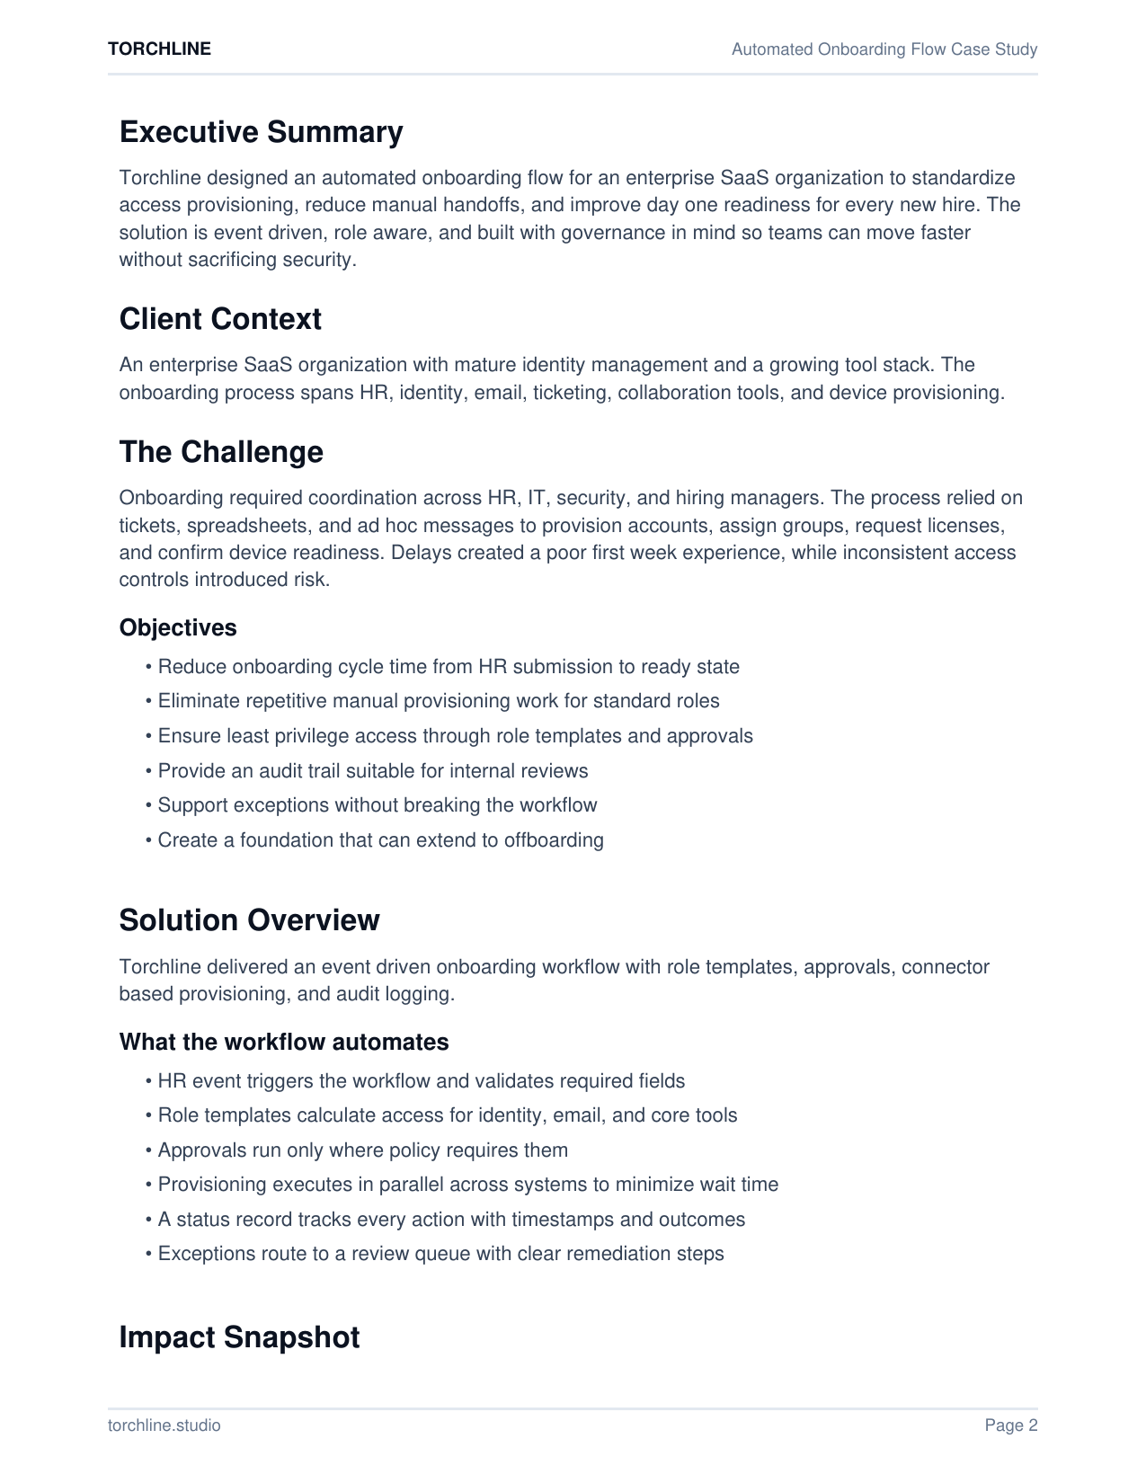
TORCHLINE
Automated Onboarding Flow Case Study
Client Context
Objectives
Enterprise SaaS organization with mature identity management and a growing tool stack. Onboarding spans HR, identity, email, ticketing, collaboration tools, and device provisioning.
Reduce onboarding cycle time from HR submission to ready state
Eliminate repetitive manual provisioning work for standard roles
Ensure least privilege access through role templates and approvals
Provide an audit trail suitable for internal reviews
Support exceptions without breaking the workflow
Create a foundation that can extend to offboarding
The challenge
Provisioning relied on tickets, spreadsheets, and follow ups across teams. Delays hurt first week experience, and inconsistent access controls introduced risk.
torchline.studio
Page 3
Notes:
[Sources] - User-provided Torchline case study PDF, page 2. [/Sources]

Slide 4
TORCHLINE
Automated Onboarding Flow Case Study
Solution Overview
Event driven onboarding workflow with role templates, approvals, connector based provisioning, and audit logging.
HR event
Validate
Role templates
Approvals
Provision
Audit log
Start date, role, manager
Required fields + policies
Groups + licenses
Only where required
Identity + apps + devices
Traceability + exports
What the workflow automates
Status record + audit trail
HR event triggers workflow and validates required fields
Role templates calculate access for identity, email, and core tools
Provisioning executes in parallel to minimize wait time
Exceptions route to a review queue with remediation steps
Every action writes a structured event with timestamp, outcome, and approver where applicable. Failures are visible, retryable, and never silent.
torchline.studio
Page 4
Notes:
[Sources] - User-provided Torchline case study PDF, page 2. [/Sources]

Slide 5
TORCHLINE
Automated Onboarding Flow Case Study
Impact Snapshot
Pilot results reflect a controlled scope focused on standard roles and highest volume onboarding paths.
Time to ready state (days)
Manual provisioning steps per hire
90% faster onboarding completion
Near zero IT touch for standard hires
Centralized audit log and dashboards
torchline.studio
Page 5
Notes:
[Sources] - User-provided Torchline case study PDF, page 3 (Impact Snapshot table). [/Sources]

Slide 6
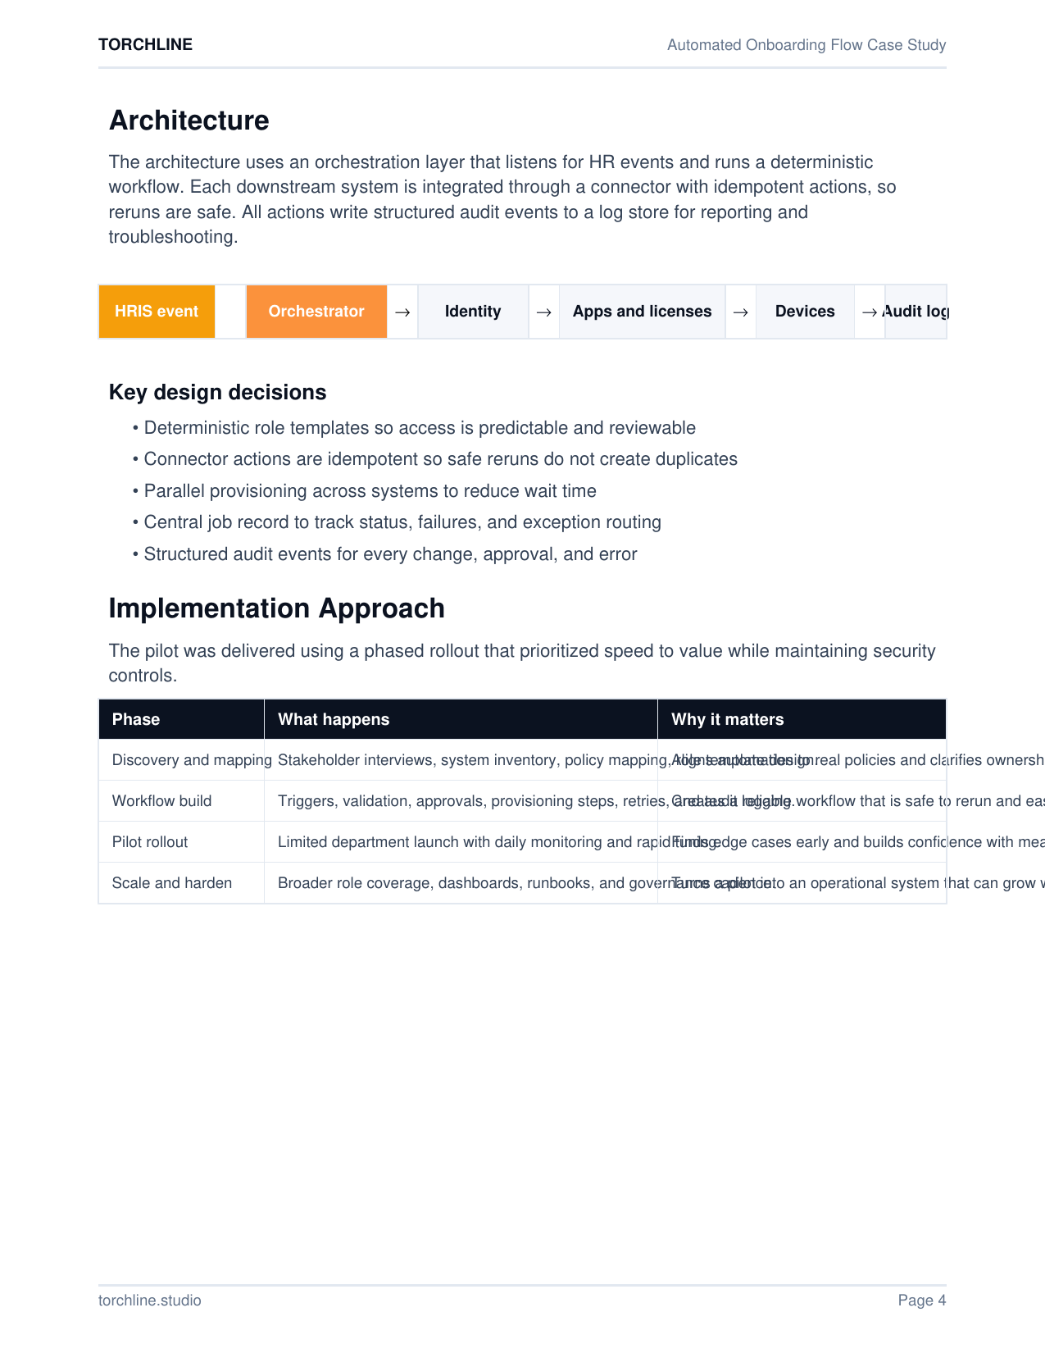
TORCHLINE
Automated Onboarding Flow Case Study
Architecture
An orchestration layer listens for HR events and runs a deterministic workflow. Downstream systems are integrated via idempotent connectors so reruns are safe. Every action writes structured audit events.
HRIS event
Orchestrator
Identity
Apps and licenses
Devices
Audit log
Key design decisions
Deterministic role templates so access is predictable and reviewable
Idempotent connector actions so reruns do not create duplicates
Parallel provisioning across systems to reduce wait time
Central job record for status, failures, and exception routing
Structured audit events for every change, approval, and error
torchline.studio
Page 6
Notes:
[Sources] - User-provided Torchline case study PDF, page 4. [/Sources]

Slide 7
TORCHLINE
Automated Onboarding Flow Case Study
Implementation Approach
Phased rollout prioritized speed to value while maintaining security controls.
Discovery and mapping
Why it matters
Stakeholder interviews, system inventory, policy mapping, role template design.
Aligns automation to real policies and clarifies ownership.
Workflow build
Why it matters
Triggers, validation, approvals, provisioning steps, retries, audit logging.
Creates a reliable workflow that is safe to rerun and easy to monitor.
Pilot rollout
Why it matters
Limited department launch with daily monitoring and rapid tuning.
Finds edge cases early and builds confidence with measurable results.
Scale and harden
Why it matters
Broader role coverage, dashboards, runbooks, governance cadence.
Turns a pilot into an operational system that can grow with the org.
torchline.studio
Page 7
Notes:
[Sources] - User-provided Torchline case study PDF, page 4 (Implementation Approach). [/Sources]

Slide 8

TORCHLINE
Automated Onboarding Flow Case Study
Security and Governance
Automation only works when it is trusted. The workflow enforces policy, reduces risk, and provides transparency for audits and internal reviews.
Controls built in
Least privilege role templates with explicit group membership and license grants
Approval gates for sensitive access such as finance, customer data, and production systems
Strong validation on HR inputs to prevent misprovisioning
Audit logging for every action including who approved and when
Idempotent provisioning to avoid duplicates and conflicting state
Secret management via platform variables and scoped tokens
Optional access review hooks for periodic recertification
Audit ready by design
Approvals, logs, and safe reruns create trust in automation.
torchline.studio
Page 8
Notes:
[Sources] - User-provided Torchline case study PDF, page 5. [/Sources]

Slide 9
TORCHLINE
Automated Onboarding Flow Case Study
Technology and Integrations
Designed to fit your stack: HRIS, identity, core SaaS, and notifications.
Reference implementation
Example integrations
Workflow orchestration: Workato, Zapier, or custom Node and Python service
Identity and access: Okta or Azure Active Directory
HR source event: Workday, BambooHR, or Rippling
Core SaaS: email, chat, ticketing, documentation, CRM
Data store: Postgres or SQLite for job state and audit logs
Notifications: Slack and email with status links
Workday
BambooHR
Rippling
Okta
Azure AD
Google Workspace
Microsoft 365
Jira
ServiceNow
Slack
Teams
Confluence
Notion
Connector library is extensible for new apps.
torchline.studio
Page 9
Notes:
[Sources] - User-provided Torchline case study PDF, page 5 and page 6 (Technology and Example integrations). [/Sources]

Slide 10
TORCHLINE
Automated Onboarding Flow
Blueprint to pilot in weeks, not quarters.
Next steps
Interested in implementing this blueprint?
Expand role templates across departments and locations
Add automated offboarding using the same event driven framework
Introduce license governance to prevent over allocation
Add access review automation for periodic entitlement validation
Track onboarding analytics including failure reasons and recovery time
Torchline can tailor the workflow to your identity stack, HRIS, and critical applications, then deliver a pilot that proves outcomes fast.
Start a Pilot
Contact: torchline.studio
Notes:
[Sources] - User-provided Torchline case study PDF, page 6 (Next Steps and CTA). [/Sources]

