Slide 1
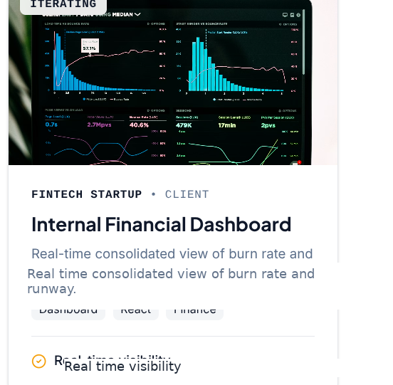
Torchline Solutions
Case study
Internal Financial Dashboard
Internal Financial Dashboard
Real time consolidated view of burn rate and runway
Dashboard
React
Finance
What it solves
A single view of burn and runway with consistent definitions and fast refresh for leadership review
Internal case study
Torchline Solutions
Notes:
[Sources] All visuals are user provided screenshots. [/Sources]

Slide 2
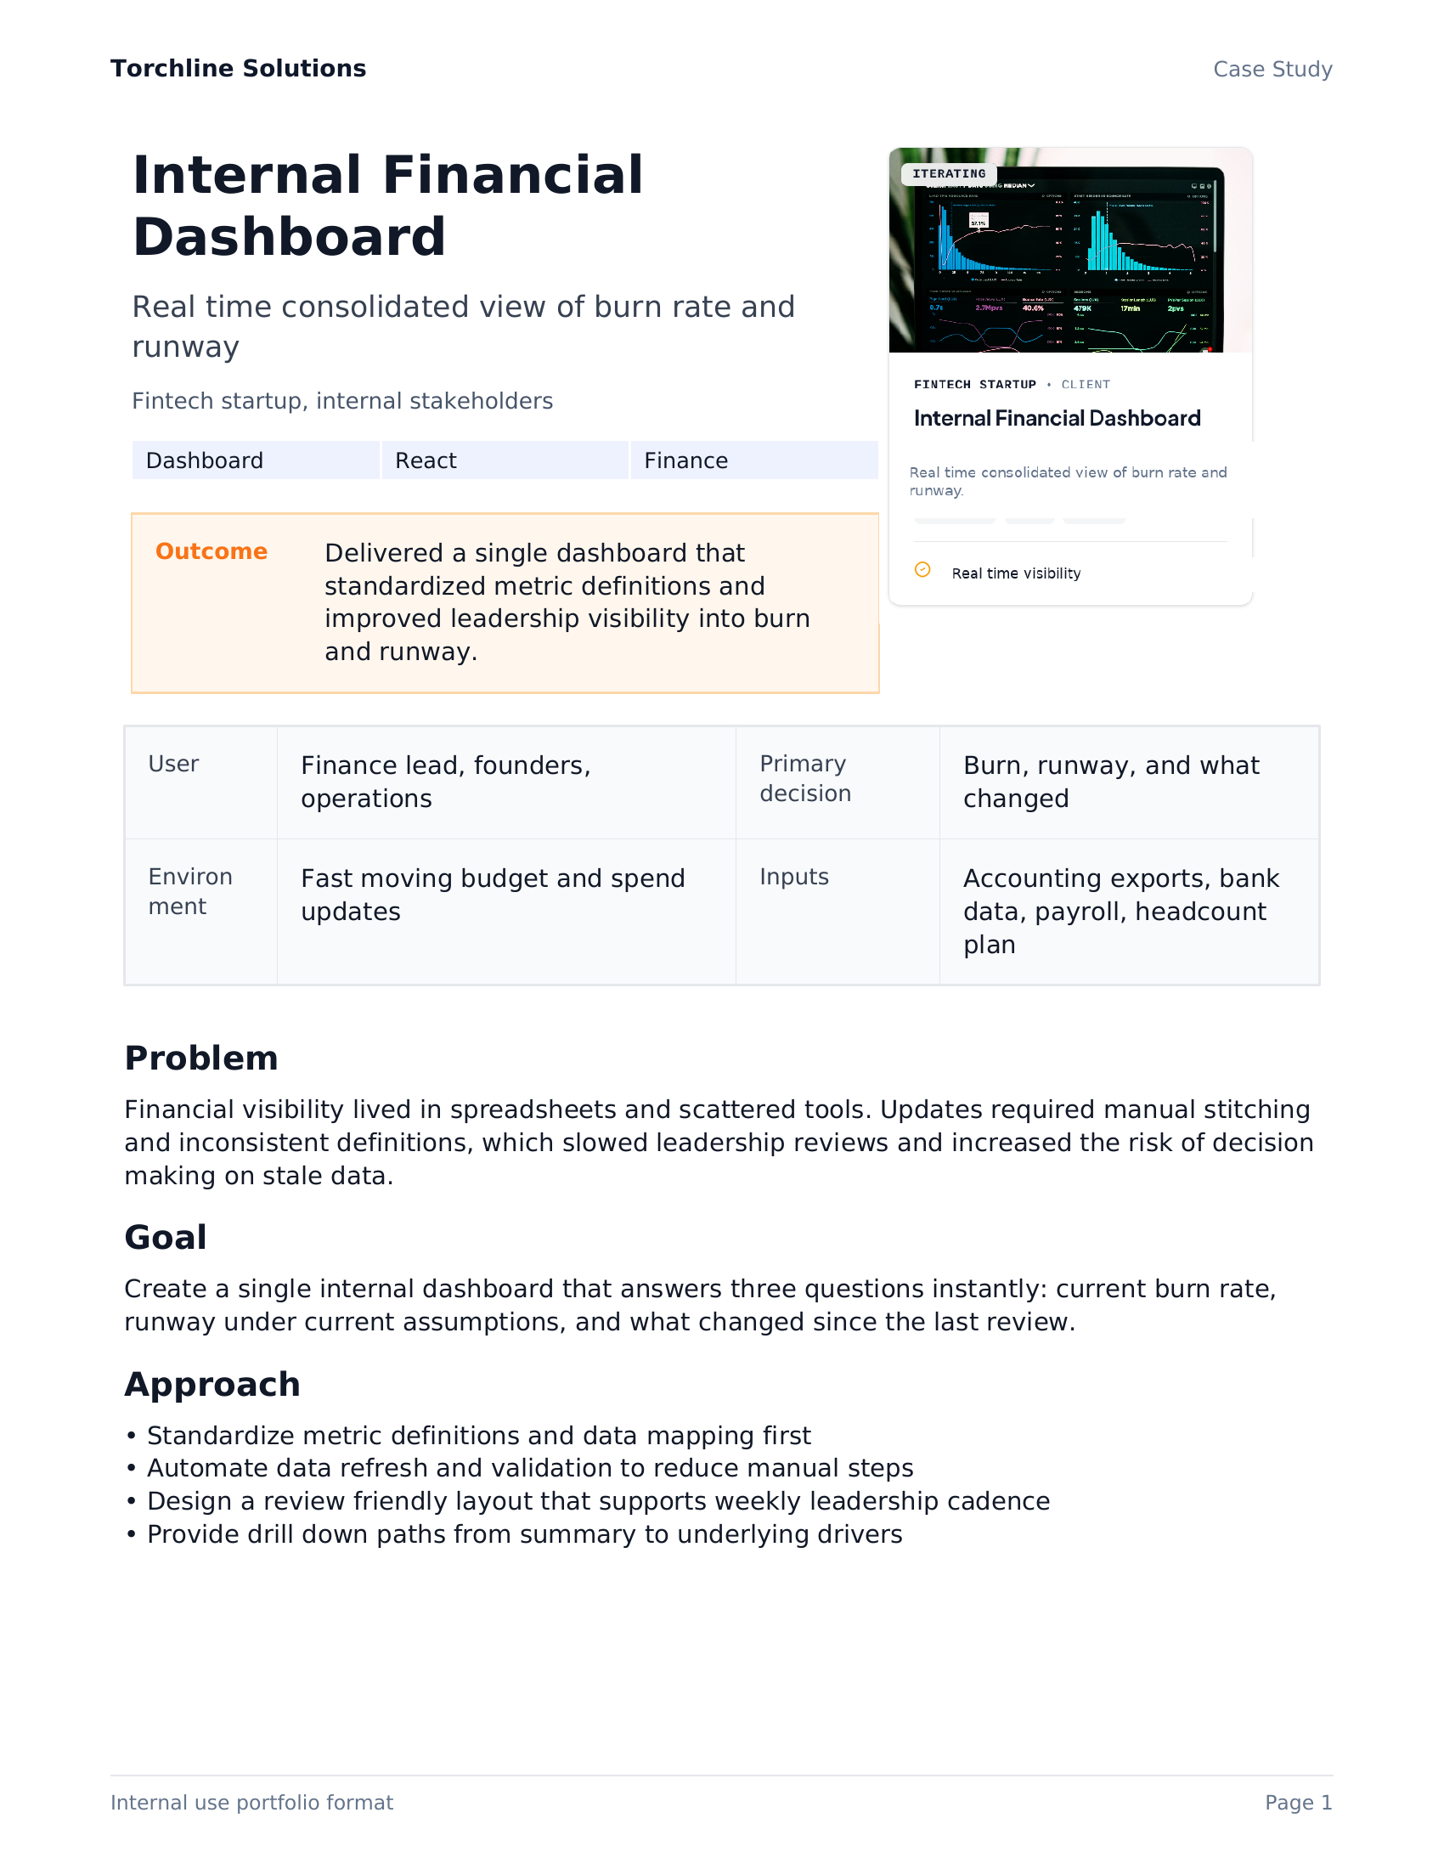
Torchline Solutions
Internal Financial Dashboard
Problem
Problem and context
Financial visibility was fragmented across spreadsheets and tools, slowing decisions about burn and runway.
Symptoms
Weekly reporting required manual stitching and repeated checks
Metric definitions differed across stakeholders
Changes in burn drivers were hard to explain quickly
Ad hoc questions created context switching for finance and ops
Constraints
Multiple sources such as bank exports, accounting reports, payroll, and headcount plans
Role based access required for sensitive data
Fast moving environment with frequent budget updates
Internal case study
Torchline Solutions
Notes:
[Sources] All visuals are user provided screenshots. [/Sources]

Slide 3
Torchline Solutions
Internal Financial Dashboard
Objectives
Objectives
Build an internal dashboard that answers three questions instantly.
What is our burn right now
What is our runway
What changed since last week
Live view of spend trends and drivers
Runway under current assumptions with scenario toggles
Variance and drivers with traceable sources
Success metrics to track
Time to prepare weekly finance review decreases
Fewer manual reconciliation steps per refresh
Stakeholders use consistent definitions for burn and runway
Drill down can trace each number back to source rows
Internal case study
Torchline Solutions
Notes:
[Sources] All visuals are user provided screenshots. [/Sources]

Slide 4
Torchline Solutions
Internal Financial Dashboard
Solution
Solution overview
A lightweight pipeline that centralizes inputs, standardizes metrics, and serves a fast internal dashboard.
Data sources
Python pipeline
Automation
Dashboard
Bank exports
Accounting
Payroll
Validation
Standardization
Metrics
Scheduled refresh
Alerts
Permissions
Burn
Runway
Drivers
Design principle
Operational principle
Deterministic validation first, then interpretation and narrative where needed
Make refresh reliable and reviewable so humans keep control over decisions
Internal case study
Torchline Solutions
Notes:
[Sources] All visuals are user provided screenshots. [/Sources]

Slide 5
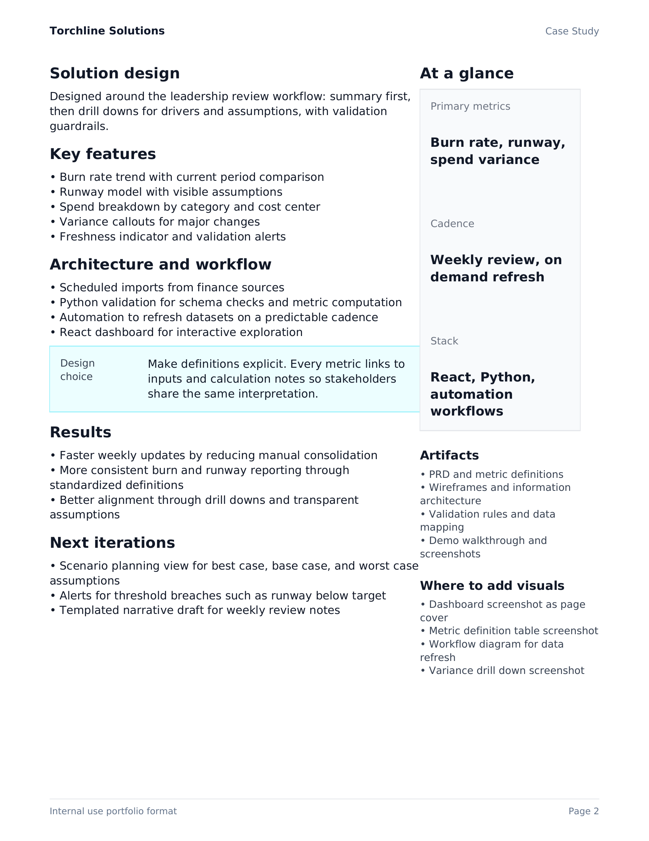
Torchline Solutions
Internal Financial Dashboard
Key features
Key features
What the dashboard provides
Real time view of burn with trend context
Runway projections with scenario assumptions
Variance drivers that explain week over week change
Drill down and traceability to source data
Role based views for sensitive categories
Product management signals
Standard definitions and metric governance
Instrumentation plan for adoption and freshness
Internal case study
Torchline Solutions
Notes:
[Sources] All visuals are user provided screenshots. [/Sources]

Slide 6
Torchline Solutions
Internal Financial Dashboard
Implementation
Implementation
Tools used
Build sequence
Python
Automation
Define burn and runway formulas with stakeholders
Stand up ingestion and validation
Deliver MVP dashboard with core views
Add driver explanations and drill down
Add alerts, permissions, and logging
React
AI
Implementation notes
Ingest and normalize exports with schema validation and audit logs
Compute metrics in a deterministic layer to prevent definition drift
Automate refresh schedule and notify stakeholders on anomalies
Use AI for narrative drafting and variance explanation with traceable references
Gate sensitive categories with role based access
Internal case study
Torchline Solutions
Notes:
[Sources] All visuals are user provided screenshots. [/Sources]

Slide 7
Torchline Solutions
Internal Financial Dashboard
Outcomes
Outcomes and impact
Delivered a repeatable reporting surface with consistent definitions and faster access to decision ready numbers.
Single source of truth
Faster leadership review
Driver transparency
Unified inputs and standardized metrics reduce confusion
Less time assembling and reconciling weekly views
Variance and drill down improves trust and actionability
What I would measure next
Weekly active stakeholders and view frequency
Time from refresh to finance review completion
Number of questions resolved via drill down without manual follow ups
Data freshness and validation failure rate
Internal case study
Torchline Solutions
Notes:
[Sources] All visuals are user provided screenshots. [/Sources]

Slide 8
Torchline Solutions
Internal Financial Dashboard
Next steps
Next iterations
A clear roadmap to deepen accuracy, explainability, and adoption.
Roadmap
Scenario builder for hiring and vendor commitments
Variance explanations linked to tagged transactions and categories
Alerts for threshold breaches and unusual spend patterns
Self serve export and audit trail for finance controls
Role based personalization for founders, finance, and ops
Want a similar build
Torchline can prototype and ship dashboards, internal tools, and AI assisted workflows designed for real operating constraints
Internal case study
Torchline Solutions
Notes:
[Sources] All visuals are user provided screenshots. [/Sources]

